Slide 1

Android Studio and how to download

Slide 2
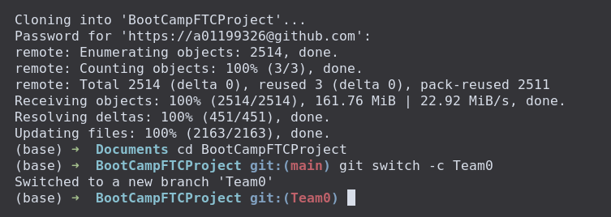
Clone into the repo
https://www.britannica.com/technology/robot-technology

Slide 3
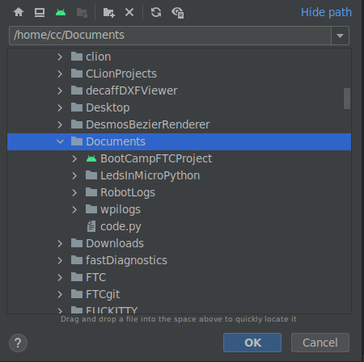
Opening it in Android Studio
https://www.britannica.com/technology/robot-technology

